Slide 1

Stock Market Analysis
Group 4

Slide 2

Group Members
Mr. Aniket Nandkishor Kapote
Mr. Ashish Chourasiya
Mrs. Nidhi Jain
Mr. Sumit A Porwal
Ms. Sreerasmi P
Ms. Sreeshma Vijayan
Mr. Syamlal S

Slide 3
Project overview
The primary objective of this dataset is to provide insights into the stock market performance of the select major companies.
Dataset timeline: 02-10-1886 to 24-08-2023
The dataset has date, ticker, Open, High, Low, Close, Volume, Adjusted Close, Dividend Amount, Stock split, Moving Avg, RSI, MACD, Bollinger Bands, 52 week high & low, Beta, Market cap, and PE ratio fields.

Slide 4

KPIs
Average Daily Trading Volume
Most volatile stocks
Stocks with Highest Dividend and Lowest Dividend
Highest and Lowest P/E Ratios
Stocks with Highest Market Cap
Stocks Near 52 Week High & Low
Stocks with Strong Buy Signals and stocks with Strong Selling Signal

Slide 5
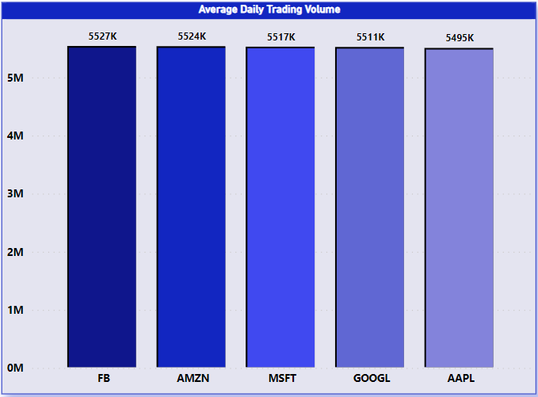
Average Daily Trading Volume
High Trading volume indicates that a stock market is highly liquid.
Liquidity refers to the ease with which assets can be bought or sold

Slide 6
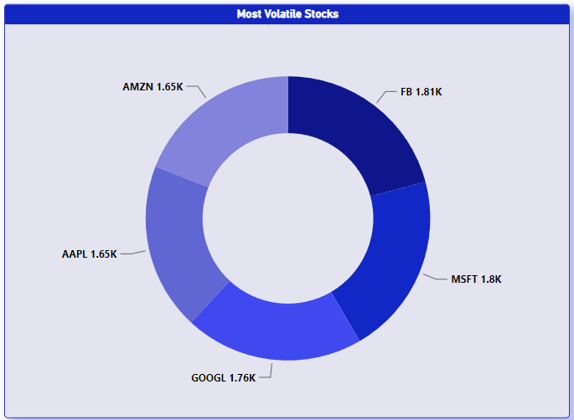
Most Volatile Stocks
Stocks with the highest beta values typically indicate that they are more volatile
have higher price sensitivity to market movements compared to overall market Index.

Slide 7
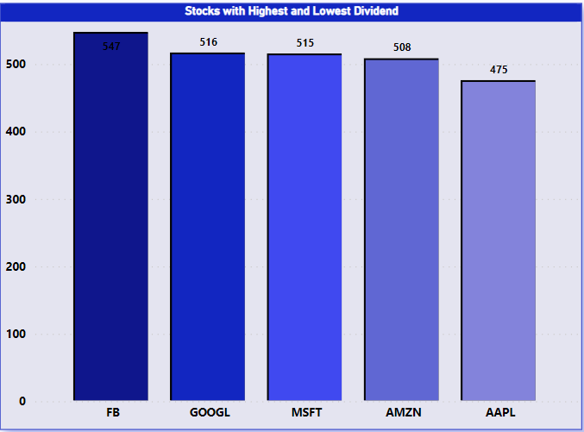
Stocks with Highest and Lowest Dividend
Stocks with low or no dividends are often associated with growth investing.
companies reinvest their earnings to fund expansion, research and development, and other growth initiatives.

Slide 8
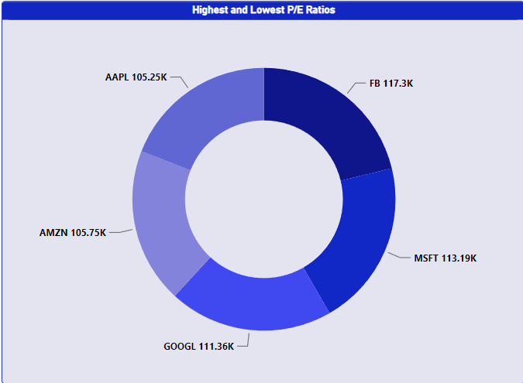
Highest & Lowest P/E Ratios
High P/E ratios are often associated with stocks that investors expect to have strong earning growth in the future.
Low P/E ratios are often associated with value stocks.

Slide 9
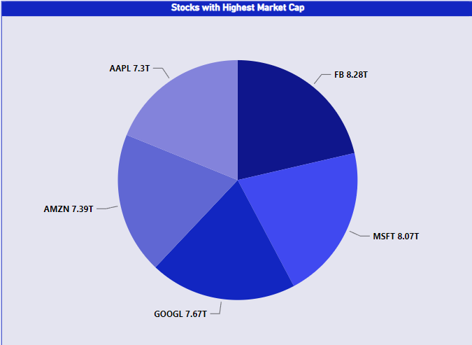
Stocks with Highest Market Cap
Stocks with the highest market cap offer stability and liquidity.
Market Cap is a measure of a company’s total market value.

Slide 10
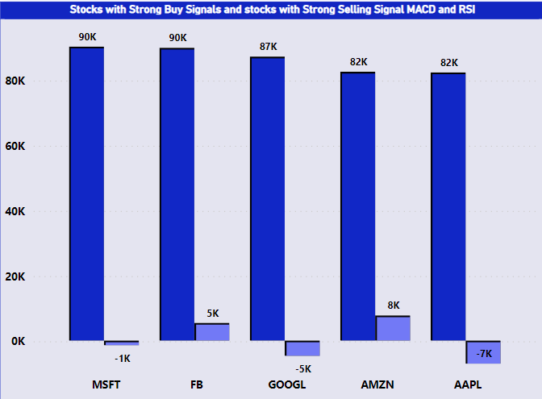
Stocks with Strong Buy Signal and Stocks with Strong Selling Signal
RSI below 45 and MACD value above 0 is considered as strong buy condition.
RSI above 69 and MACD below 0 is considered as strong selling condition.

Slide 11

Analysis
Identified patterns, trends, and anomalies in the stock’s behaviour over time.
Made informed decisions regarding the stock purchases, sales, or holdings, potentially.

Slide 12

Recommendation
Prioritize stocks with high average daily trading volumes for investment to ensure liquidity and ease of trading.
For investors with a higher risk tolerance, consider investing in stocks with high beta values, as these stocks are more volatile and can offer significant short-term gains.
For stable income, invest in stocks with high dividend payouts. For long-term growth, consider stocks with low or no dividends, as these companies may reinvest earnings for expansion.

Slide 13
Recommendation
Invest in stocks with high P/E ratios for potential high growth opportunities. Consider stocks with low P/E ratios for value investing, as these may be undervalued by the market.
Include stocks with high market capitalizations in your portfolio for stability and lower risk, as these companies are typically well-established and less volatile.
For momentum investing, consider stocks near their 52-week highs. Be cautious with stocks near their 52-week lows unless there is a clear recovery signal, as these might indicate underlying issues.

Slide 14
Conclusion
The complete analysis on how big companies perform in the stock market using the given dataset provides important indications about various key performance indicators.
Investors can make decisions on stock purchase, sale or holding by considering average daily trading volume and volatility (beta values), dividend payouts, P/E ratios, market capitalization and stocks near 52-week highs and lows among other metrics.
Furthermore, technical indicators such as RSI, MACD and Bollinger Bands help in identifying strong buy/sell signals that improve decision-making process.
This analysis is crucial because it helps to understand both past and present behavior of the market but also assists in predicting its future trends thus contributing into more strategic and possibly profitable investment choices.

Slide 15

THANK YOU

